Slide 1

Lower Division Coaches Meeting – January 29, 2026

Slide 2

Introduction
Coaching:
  Model good behavior for players
  Opportunities for all
  Help players develop skills, love of game
  Positive experience for players & parents
  Have FUN!!!

Slide 3

Lower Division Tips
Show up with a practice plan
Break up kids into groups of 3-4
Have at least 2 Parents in dugout to manage the line-up
Good Communication with Parents
Know your audience (kids & parents are always listening)
No tobacco, vaping, sunflower seeds!!

Slide 4


2026
Areas of improvement
Utilize your players parents. They need to step up and help!
Show up with a practice plan
Appointing a team Parent to assist with communication. This is a must!!!
Coaching obligation to participate in league events with team.
  OPENING DAY MARCH 7TH
  HRD/PICTURE DAY APRIL 12, 2026

Slide 5

Important Dates
  January 17, 2026 at 9:00 a.m.: Player Assessments at Morse Park
  January 30, 2026: Major Draft 6p.m. / Minor Draft 8pm Franklin H.S.
  January 31, 2026: AAA Draft at 8am / AA Draft10a.m. Franklin H.S.
  February 2, 2026: Team Practices may begin
  February 13, 2026 at 7:00 p.m.: Team Rep. Meeting Franklin HS
  February 19, 2026 at 6:30 p.m.: Scorekeeper’s Clinic
  February 21, 2026: Umpires Clinic
  March 1, 2026: Fields Day at Morse Park
  March 7, 2026: Opening Day

Slide 6
More Important Dates
April 1, 2026: All-Star Coach Interviews
April 12, 2026: Home Run Derby and Picture Day
April 15, 2026: All Star Coaches Meeting
April 19, 2026: All Star Tryouts
April 23, 2026: All Star Parent Meeting
May 16, 2026: Closing Ceremonies
Movie Night / Ac. All Am / Div All Stars

Slide 7
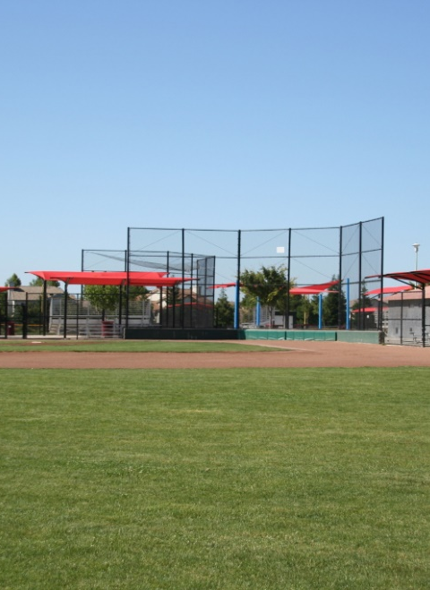
Fields
Taking care of the Fields
  Locking sheds always. We need the items in the sheds to take care of our fields properly. This includes ensuring tools are returned in an orderly fashion and not just thrown back in the shed.
  Letting your DM know when something needs attention (material, leaks, etc. IMMEDIATELY – being proactive is helpful. The fields person cannot be everywhere.
  Coaches are responsible for learning as well as teaching the proper way to prep and breakdown a field. If you see that fields are being taken care of incorrectly, say something.
  Pictures and Descriptions will be updated in sheds. First practice you need to have a sign up for your parents. Let them know they will need to do field prep and breakdown. Once your crew has been assigned, go over the proper way to maintain the fields with them. If you need a board member to help with this, please reach out. We can come out to your practice.
Fields day – What to expect
Fields Day = Saturday, 3/1/2026 – AT LEAST 2 COACHES MUST BE PRESENT. BRING YOUR FIELDS CREW
  This is a requirement so that everyone understands the expectation and proper ways to maintain the field.

Slide 8

BACKGROUND CHECKS AND APS TRAINING
THE FOLLOWING ITEMS MUST BE COMPLETED BEFORE 2/1/2026
***SAME AS LAST YEAR***
2026 Babe Ruth Membership Required
Live Scan (TODAY)
Mandated Reporter Training (You will receive an email with an assigned training with a due date)
Babe Ruth League Background Check (Code provided to you for payment)
Babe Ruth required APS Training (Instructions will be emailed )
Coaching Certificate (Coaching the Babe Ruth Way) Fee to be paid by you
PLEASE LOGIN TO YOUR SPORTSENGINE ACCOUNT FROM LAST YEAR AND CHECK THE CURRENT
STATUS OF ALL BABE RUTH ITEMS - CHECK SPREADSHEET

Slide 9
Practice – Do’s and Don’ts
Do’s
  Use your assigned practice field at the times assigned to you
  Make sure you are off the field and have prepared it for the next team by the time the next practice is scheduled to start
  Use stations to keep players busy

Slide 10
Practice – Do’s and Don’ts
Don’ts
  Use fields that are not assigned to LYB such as BSP
  Don’t practice on fields when LYB or CSD has closed the fields
  Don’t use fields if you can tell that they are too wet for play. / Notify your DM
  Don’t cancel games unless the League has cancelled them.

Slide 11
REMINDER ABOUT RULES
Parent Conduct – It is the responsibility of coaches to control their parents. Not the umpires. Coaches will be ejected if parents behavior is unbecoming.
Make sure you read the rules for your division and you agree on game plan before game with the other coach.
  Score is not kept
  All teams receive a trophy

Slide 12
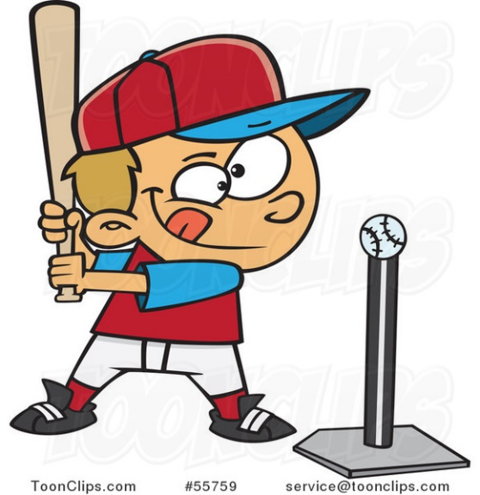
ROOKIE RULES
16.13.3 Rookie Division: A coach will pitch to his own team the entire season. Batters will receive a maximum of 5 pitches, and 3 attempts with a tee per at bat. At the end of the fifth pitch, if a player has not batted the ball into fair play he/she will have 3 opportunities to put the ball into play hitting off the tee. Additionally, while a coach is pitching a defensive player will be placed at the pitcher position to field. There are no walks or hit batsmen.

Slide 13
SINGLE A RULES
16.13.2 A Division: A coach will pitch to his own team, the entire game, for the first six (6) scheduled games of the season. A batter will receive a maximum of seven (7) pitches per at bat. A batter is ruled out if he swings and misses at three pitched balls. A foul tip on the third strike that is caught by the catcher is a strike out. At the end of the seventh pitch, if a player has not batted the ball into fair play he/she will be ruled a strikeout. If the player hits a foul ball on the seventh pitch or any pitch after the seventh, the player will receive another pitch. Players will pitch for the first three innings of games 7 through 16. Coaches will pitch to their team the balance of the innings in these games using the same pitching rules for games 1-6. Players will be limited to pitching one (1) inning per game and two (2) innings per week. Players will be limited to two (2) innings per game and four (4) innings per week. When players are pitching, if a batter is hit by the pitch, the batter has the choice of going to first base or remaining at bat with the pitch being called a ball. If a batter is thrown four balls by the opposing team’s pitcher, the batter will receive 3 hittable pitches from their coach in an attempt to put the ball in play. At the end of the third hittable pitch, if a player has not batted the ball into fair play he/she will be ruled a strikeout. If the player hits a foul ball on the third pitch or any pitch after the third, the player will receive another pitch.

Slide 14

Division Managers
Roles of Division Managers
  Liaison between Coaches and Board
    ERIC STURGES Rookie / Minors
      Rookies@lagunayouthbaseball.org
      Minors@lagunayouthbaseball.org
        A chat will be created for your division
    TODD LYON – AA / Majors
      AA@lagunayouthbaseball.org
      Majors@lagunayouthbaseball.org
        A chat will be created for your division
    RICHARD KING – AAA / Single A
      AAA@lagunayouthbaseball.org
      SingleA@lagunayouthbaseball.org
        A chat will be created for your division

Slide 15
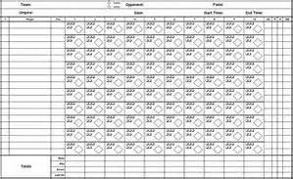
Scorekeeper’s Clinic
Clinic will be held February 19th
If you or someone you know would like to start learning they are free to come to the clinic.
Training is basic scorekeeping, most important is
tracking individual playing time and pitch
counts.

Slide 16

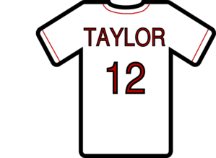
Equipment Manager
When/where to get equipment
  Unusual or additional equipment requests
Uniforms / Apparel
Uniforms
  This years plan.
  What to do if you have jerseys that don’t fit?

Slide 17

Snack Bar
Expectation that all teams will provide volunteers for every shift team is assigned, typically 1-2 shifts during the season
  Need at least 4 volunteers on Saturday afternoon shifts as well as Friday nights. All other shifts only need 3. Only one can be a teenager, whom must be at least 14 yrs old.
  Team Parent will be the main point of contact for the snack bar managers to ensure slots are filled.
  Sign-Up Genius website will be used to schedule shift and text reminders will go out the day before to all volunteers.
  If your team has difficulty getting volunteers for your assigned day/time, you must work out a trade with a different team and inform the snack bar managers.

Slide 18


IF YOU EVER HAVE A CONCERN PLEASE REACH OUT. IF YOU HAVE A COMPLAINT, PLEASE REACH OUT TO THE BOARD IN A RESPECTFUL MANNER AND REFRAIN FROM BASHING IN GROUP CHATS. THE CHATS WITH THE DM’S ARE TO EXCHANGE USEFUL INFORMATION ONLY. WE WOULD LIKE TO SOLVE ANY ISSUE THAT ARISES AND IT IS MUCH EASIER IF WE COME FROM A RESPECTFUL PLACE.
MOST IMPORTANTLY……
THANK YOU! THANK YOU FOR DEVOTING YOUR TIME TO LAGUNA YOUTH BASEBALL AND OUR COMMUNITY.
WE UNDERSTAND THAT THIS CAN BE CHALLENGING AT TIMES AND THAT YOUR TIME IS PRECIOUS. WE APPRECIATE EVERYTHING YOU PUT INTO THIS, AND OUR GOAL IS TO ENSURE THAT YOU AND ALL THE FAMILIES IN OUR LEAGUE HAVE THE BEST EXPERIENCE POSSIBLE.
- LYB BOARD OF DIRECTORS

