Slide 1

2026 Upper Division Coaches Meeting

Slide 2

Important Dates
  January 17, 2026 at 9:00 a.m.: Player Assessments at Morse Park
  January 30, 2026: Major Draft 6p.m. / Minor Draft 8pm Franklin H.S.
  January 31, 2026: AAA Draft at 8am / AA Draft10a.m. Franklin H.S.
  February 2, 2026: Team Practices may begin
  February 13, 2026 at 7:00 p.m.: Team Rep. Meeting Franklin HS
  February 19, 2026 at 6:30 p.m.: Scorekeeper’s Clinic
  February 21, 2026: Umpires Clinic @ Franklin H.S.
  March 1, 2026: Fields Day at Morse Park
  March 7, 2026: Opening Day

Slide 3

Important Dates (Cont’d)
April 1, 2026: All-Star Coach Interviews
April 12, 2026: Home Run Derby and Picture Day
April 15, 2026: All Star Coaches Meeting
April 19, 2026: All Star Tryouts
April 23, 2026: All Star Parent Meeting
May 16, 2026: Closing Ceremonies
Movie Night / Ac. All Am / Div All Stars

Slide 4
REMINDERS
All players have the opportunity to play all positions
Show up with a practice plan / Consistent communication
Appointing a team Parent to assist with communication. This is a must!!!
Know your audience (kids & parents listening)
Umpire / Coach Communication
Chewing tobacco, smoking &/or vaping **PROHIBITED**
Seeds in dugouts or on fields **PROHIBITED**
Gum should not be in the dugout. Last year we had a huge problem with gum in the dugout.
Coaching obligation to participate in league events with team.
OPENING DAY MARCH 7TH / HRD & PICTURE DAY APRIL 12TH

Slide 5

BACKGROUND CHECKS AND APS TRAINING
THE FOLLOWING ITEMS MUST BE COMPLETED BEFORE 2/1/2026
***SAME AS LAST YEAR***
2026 Babe Ruth Membership Required
Live Scan (AGAIN ON 1/29/26 IF YOU MISSED TODAY)
Mandated Reporter Training (You will receive an email with an assigned training with a due date)
Babe Ruth League Background Check (Code provided to you for payment)
Babe Ruth required APS Training (Instructions will be emailed )
Coaching Certificate (Coaching the Babe Ruth Way) Fee to be paid by you
PLEASE LOGIN TO YOUR SPORTSENGINE ACCOUNT FROM LAST YEAR AND CHECK THE CURRENT
STATUS OF ALL BABE RUTH ITEMS - CHECK SPREADSHEET

Slide 6
Practice – Do’s and Don’ts
Do’s
  Use your assigned practice field at the times assigned to you
  Make sure you are off the field and have prepared it for the next team by the time the next practice is scheduled to start
  Use stations to keep players busy
Don’ts
  Use fields that are not assigned to LYB such as BSP
  Don’t practice on fields when LYB or CSD has closed the fields
  Don’t use fields if you can tell that they are too wet for play. / notify your DM

Slide 7

Highlighted Rules
PRINT, READ & KEEP THE COACHES MANUAL!!!
www.lagunayouthbaseball.org
  USA BAT RULE
  15.1 Number of Innings (Every player on a team must sit out 1 inning of defense before any player on the team can sit out a second inning of defense)
  16.2 Player on Field Rule (8 players)
  **New**Pitcher Rest Rule 16.12.1
  16.16.4 Four Run Rule (Single A & AA)
  **New**16.17.6 Run Rule Minors

Slide 8
Reminders
Regular season playing time – positions
  In AAA, Minor and Major it is mandatory to move players around during the regular season and all players should be given the chance to play an outfield and an infield position in each game.
  In AA, There is a 4 Run Rule. Each player should play at least two innings of infield each game. No player may play more than 2 innings in any position in any game.
Coaches and Players must participate in 8 complete games to be considered for All-Stars and coaching the following season.
Games Protests – Read process in Rule Book
  If process isn’t followed. Protest will be null.
Parent Conduct – It is the responsibility of coaches to control their parents. Not the umpires. Coaches will be ejected if parents behavior is unbecoming. Please contact your DM if you are having an issue with parents, ASAP

Slide 9
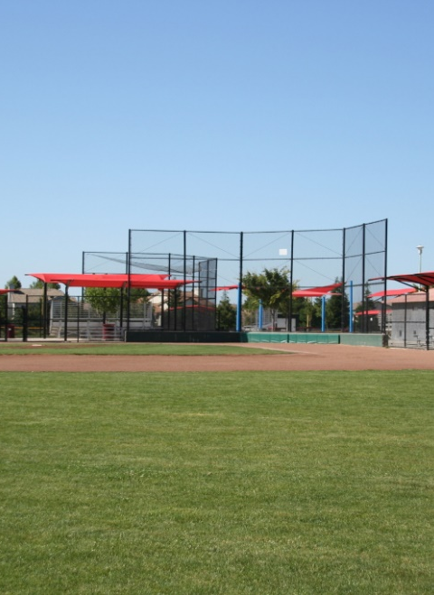
Fields
Taking care of the Fields
  Locking sheds always. We need the items in the sheds to take care of our fields properly. This includes ensuring tools are returned in an orderly fashion and not just thrown back in the shed.
  Letting your DM know when something needs attention (material, leaks, etc. IMMEDIATELY – being proactive is helpful. The fields person cannot be everywhere.
  Coaches are responsible for learning as well as teaching the proper way to prep and breakdown a field. If you see that fields are being taken care of incorrectly, say something.
  Pictures and Descriptions will be updated in sheds. First practice you need to have a sign up for your parents. Let them know they will need to do field prep and breakdown. Once your crew has been assigned, go over the proper way to maintain the fields with them. If you need a board member to help with this, please reach out. We can come out to your practice.
Fields day – What to expect
Fields Day = Saturday, 2/28/2026 – AT LEAST 1 COACH FROM EACH TEAM MUST BE PRESENT. BRING YOUR FIELDS CREW
  This is a requirement so that everyone understands the expectation and proper ways to maintain the field.

Slide 10

Player Agent
Number of Players expected: 525
Number of Teams:
  Majors: 6
  Minors: 8
  AAA: 6
  AA: 8
  Single A: 8
  Rookie: 7

Slide 11

Player Agent
Player Assessments – what to expect
  Assessment grid and add-ons
  Assessment process
  Ages for each division to watch
  Conduct at assessments
  Draft order

Slide 12
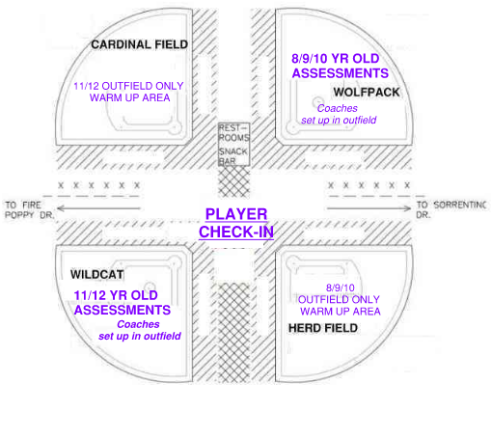
2026 ASSESSMENT SCHEDULE
WOLFPACK FIELD
7&8 year olds 9:00AM - 11:00AM
• Last name A-G: check in at 8:40am, assessments starting at 9:00am
• Last name H-L: check in at 9:10am, assessments starting at 9:40am
• Last name M-S: check in at 9:40am, assessments starting at 10:10am
• Last name T-Z: check in at 10:10am, assessments starting at 10:40am
9 year olds 11:30AM - 12:30PM
• Last name A-E: check in at 10:40am, assessments starting at 11:30am
• Last name F-S: check in at 11:10am, assessments starting at 12:30am
• Last name T-Z: check in at 11:40am, assessments starting at 12:30pm
10 year olds 1:00PM - 2:00PM
• Last name A-L: check in at 12:10pm, assessments starting at 1:00pm
• Last name M-Z: check in at 12:40pm, assessments starting at 1:30pm
WILDCAT FIELD
12 year olds 9:30AM - 11:00AM
• Last name A-L: check in at 9:10am, assessments starting at 9:30am
• Last name M-R: check in at 9:40am, assessments starting at 10:10am
• Last name S-Z: check in at 10:10am, assessments starting at 10:40am
11 year olds 11:30AM - 1:00PM
• Last name A-L: check in at 10:40am, assessments starting at 11:30am
• Last name M-S: check in at 11:10am, assessments starting at 12:00am
• Last name R-Z: check in at 11:40am, assessments starting at 12:30pm

Slide 13
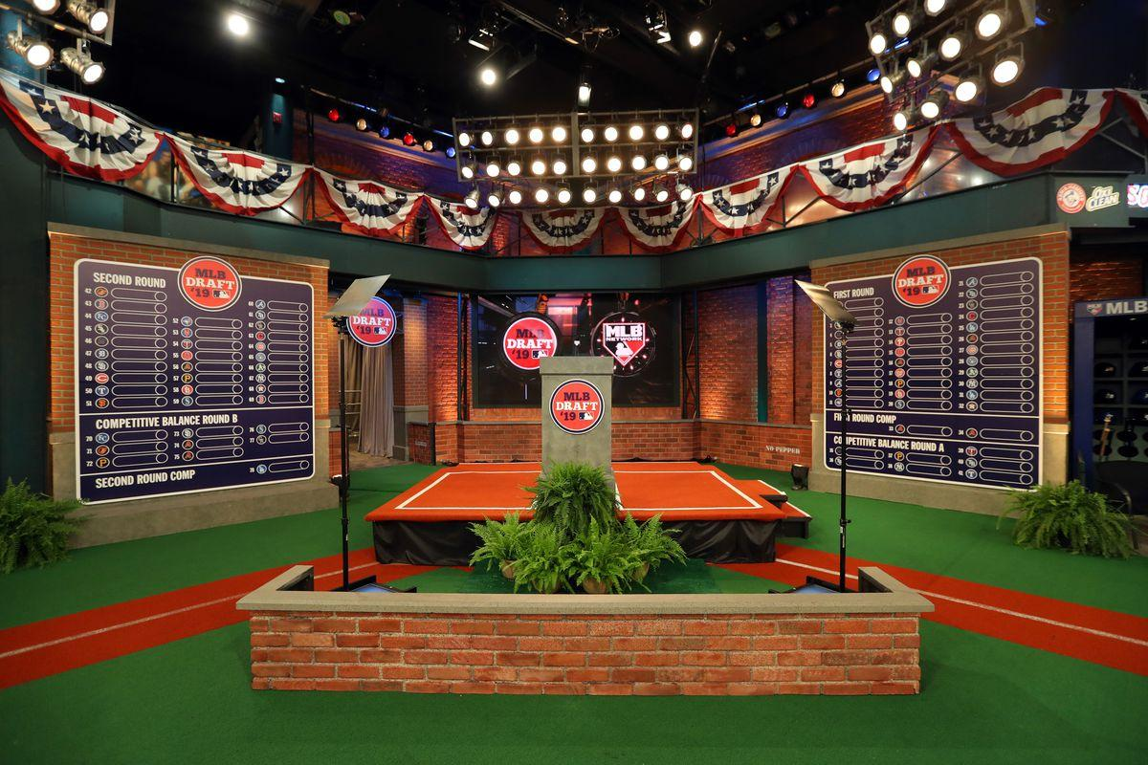
Player Agent
Draft– what to expect
  Draft grid
  Unless we need additional coaches in a division, all players who tryout are draft eligible
  Players who do not tryout are randomly placed on teams. Random placements are also made to fill in open boxes in the coaches’ players boxes

Slide 14

Player Agent
Draft (cont.)
  NO CHILDREN AT THE DRAFT!!!!!!!!!
  List of players eligible to be drafted
  Draft process
  Trades after draft – 20 minutes
  Walk out with copy of final roster

Slide 15

Division Managers
Roles of Division Managers
  Liaison between Coaches and Board
    ERIC STURGES Rookie / Minors
      Rookies@lagunayouthbaseball.org
      Minors@lagunayouthbaseball.org
        A chat will be created for your division
    TODD LYON – AA / Majors
      AA@lagunayouthbaseball.org
      Majors@lagunayouthbaseball.org
        A chat will be created for your division
    RICHARD KING – AAA / Single A
      AAA@lagunayouthbaseball.org
      SingleA@lagunayouthbaseball.org
        A chat will be created for your division

Slide 16

Umpires
What to expect from umpires
Questions, concerns, or complaints regarding umpires – Contact your Division Manager at
        AA@lagunayouthbaseball.org
        AAA@lagunayouthbaseball.org
        Minors@lagunayouthbaseball.org
        Majors@lagunayouthbaseball.org
  If you have an umpire not show up to a game or need immediate attention, call/text 916-275-7044
  Provide your name, field, division level, and issue/question

Slide 17

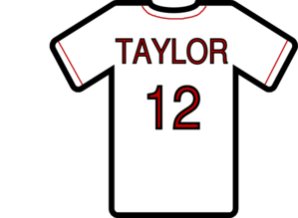

**Equipment Manager**
Pickup equipment tonight!! Game Balls & Bags
  Unusual or additional equipment requests
**Uniforms / Apparel**
Uniforms
  This years plan.
  What to do if you have jerseys that don’t fit?
**2026 All Stars**
Coaching Selection Process
This years changes

Slide 18

Snack Bar
Expectation that all teams will provide volunteers for every shift team is assigned, typically 1-2 shifts during the season
  Need at least 4 volunteers on Saturday afternoon shifts as well as Friday nights. All other shifts only need 3. Only one can be a teenager, whom must be at least 14 yrs old.
  Team Parent will be the main point of contact for the snack bar managers to ensure slots are filled.
  Sign-Up Genius website will be used to schedule shift and text reminders will go out the day before to all volunteers.
  If your team has difficulty getting volunteers for your assigned day/time, please work out a trade with a different team and inform the snack bar managers.

Slide 19
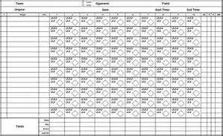
Scorekeeper’s Clinic
Must have at least two scorekeeper volunteers
Clinic will be held February 19th
Team scorebook will be passed out during the clinic, if your scorekeepers are not new, they do not need to attend the training, only pick up the scorebook
Training is basic scorekeeping, most important is
tracking individual playing time and pitch
counts
Scorebooks will be audited two times during
the regular season

Slide 20

THANK YOU! THANK YOU FOR DEVOTING YOUR TIME TO LAGUNA YOUTH BASEBALL AND OUR COMMUNITY.
WE UNDERSTAND THAT COACHING CAN BE CHALLENGING AT TIMES AND THAT YOUR TIME IS PRECIOUS. WE APPRECIATE EVERYTHING YOU PUT INTO THIS, AND OUR GOAL IS TO ENSURE THAT YOU AND ALL THE FAMILIES IN OUR LEAGUE HAVE THE BEST EXPERIENCE POSSIBLE.
- LYB BOARD OF DIRECTORS

